Slide 1
Maximum Likelihood Estimators
Jackson Barth, Chenyu (Devon) Yang, Ming Zhang
November 19, 2019

Slide 2
MLE - Introduction
Motivation: Determining the distribution of observation
Best all-purpose approach for statistical analysis
Consistent, asymptotically unbiased and efficient (Under mild conditions)
Focused on computational performance
Several different methods can be used

Slide 3
Contents
Traditional MLE
What is MLE?
Assumptions and Asymptotic Normality
Estimating Variance
Scoring
EM Algorithm
What is the EM algorithm?
Monte Carlo EM Approach
Example 1: Multinomial
Example 2: Gaussian Mixture Model

Slide 4
Traditional MLE

Slide 5
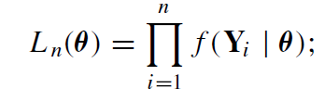
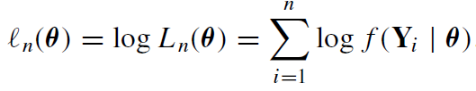
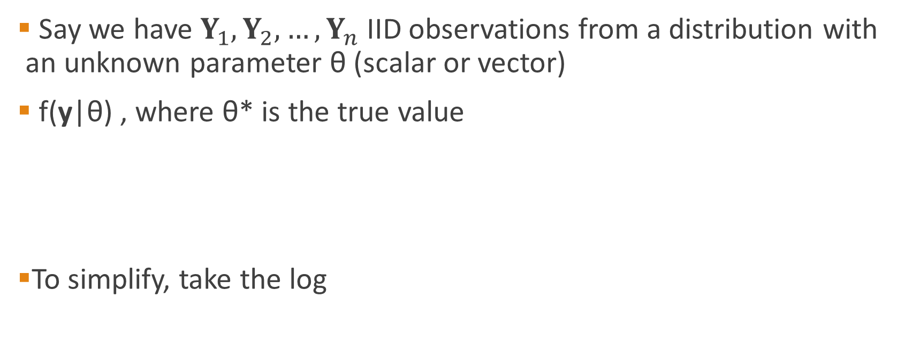
What is MLE?
Say we have $Y_{1},Y_{2},…,Y_{n}$ IID observations from a distribution with an unknown parameter θ (scalar or vector)
f(y|θ) , where θ* is the true value
To simplify, take the log

Slide 6
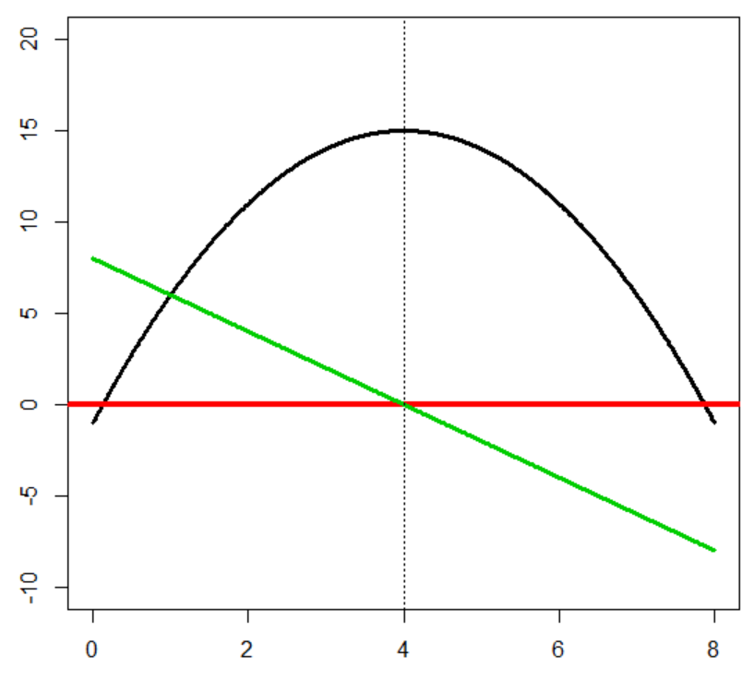

What is MLE?
Take the first derivative of the log likelihood function
Solve for the roots
Newton’s Method, Scoring
We refer to this as the Traditional MLE method
Likelihood Function
First Derivative

Slide 7


Example 1 – Analytical Solution
We have observations 0,0,1,1,1,2,2,2,3,3 from a distribution with the below pmf
For what value of θ is the below likelihood function maximized?
*Example from http://people.missouristate.edu/songfengzheng/Teaching/MTH541/Lecture%20notes/MLE.pdf

Slide 8

What is MLE?
Let $E_{θ}[g\left(Y\right)]$ denote the expectation of a function of the variable with respect to θ
θ* maximizes the true value of this Log-Likelihood function
Law of Large Numbers

Slide 9
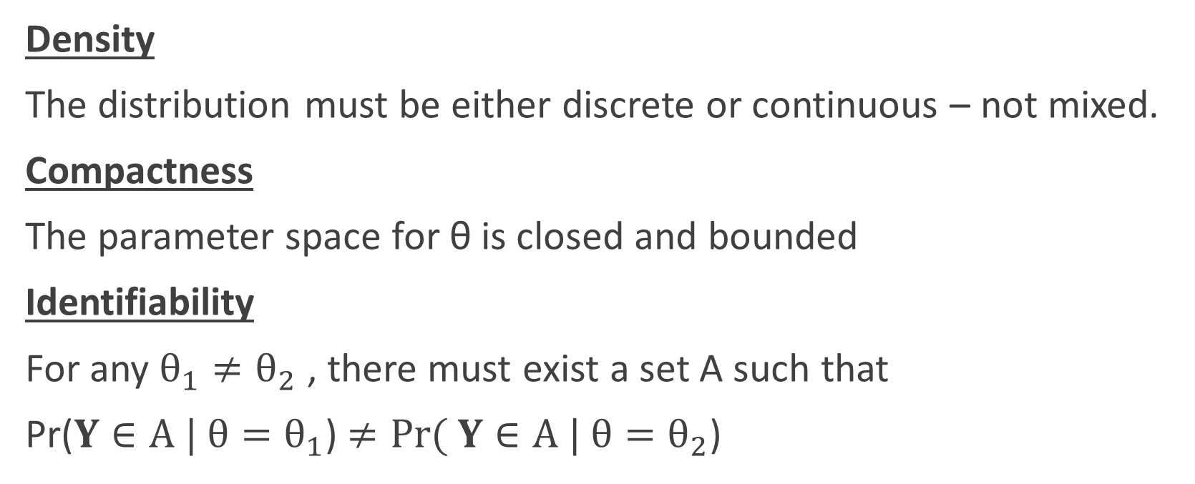
Assumptions for MLE
Density
The distribution must be either discrete or continuous – not mixed.
Compactness
The parameter space for θ is closed and bounded
Identifiability
For any $θ_{1}≠θ_{2}$ , there must exist a set A such that
Pr($Y∈A | θ=θ_{1}$) $≠Pr( Y∈A | θ=θ_{2}$)

Slide 10
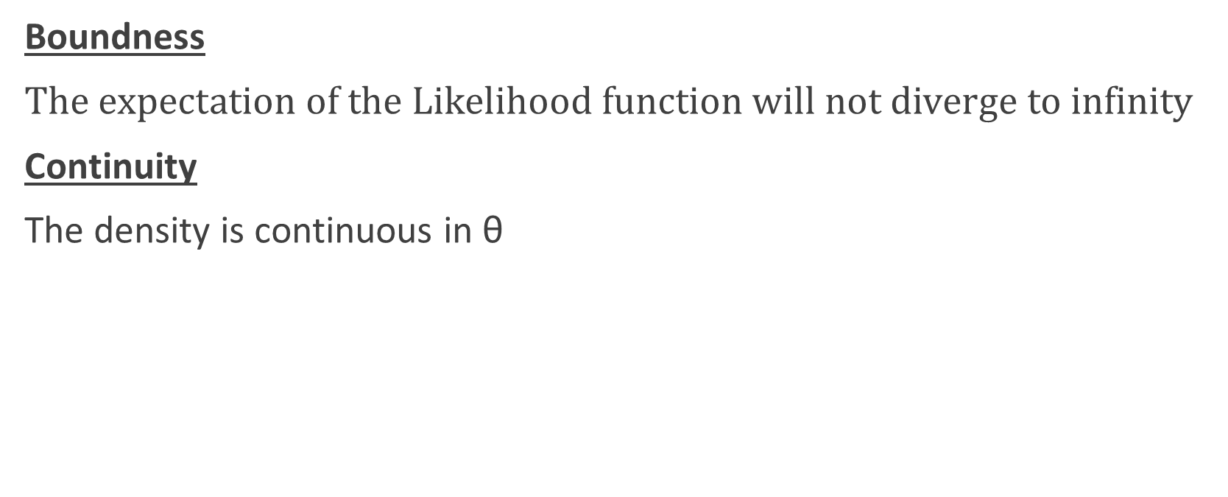
Assumptions (cont.)
Boundness
$The expectation of the Likelihood function will not diverge to infinity$
Continuity
The density is continuous in θ

Slide 11
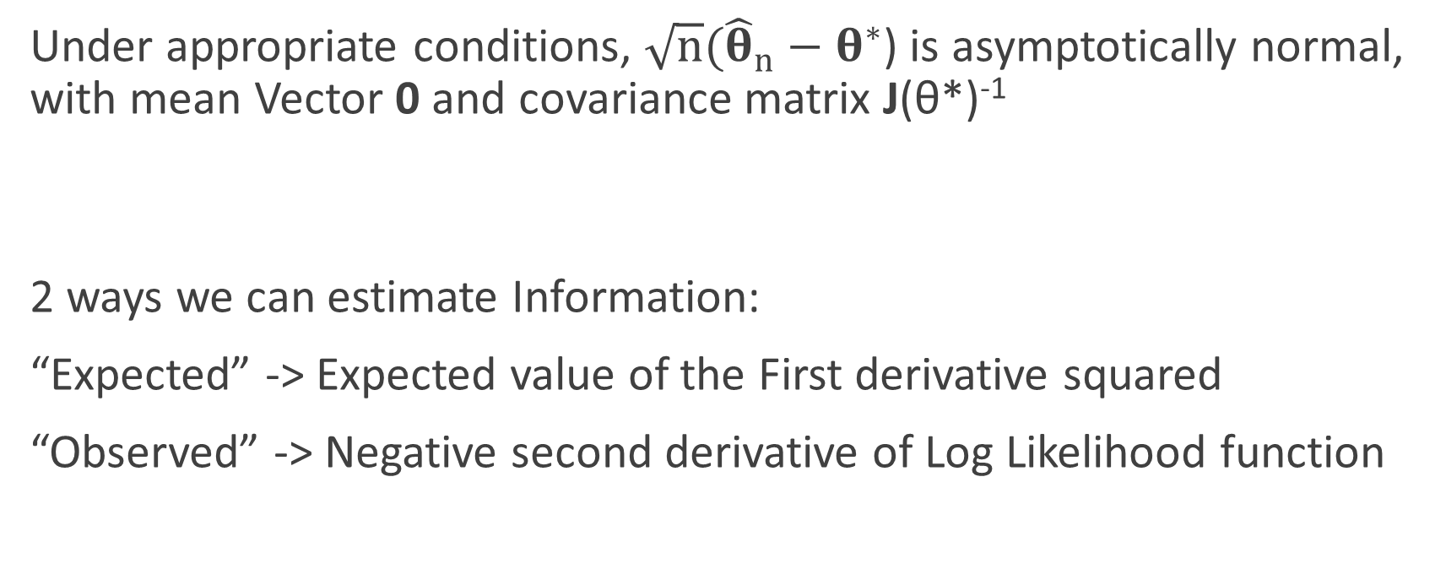
Asymptotic Normality
Under appropriate conditions, $\sqrt{n}({\hat{θ}}_{n}−θ^{∗}$) is asymptotically normal, with mean Vector 0 and covariance matrix J(θ*)⁻¹
2 ways we can estimate Information:
“Expected” -> Expected value of the First derivative squared
“Observed” -> Negative second derivative of Log Likelihood function
J = Fisher’s Information Matrix

Slide 12

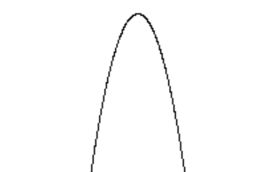
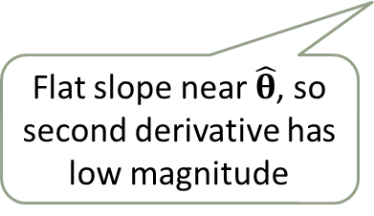
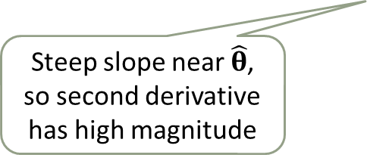


Fisher’s Information Matrix
High Variance
c
Low Information: Unreliable Estimate
Flat slope near $\hat{θ}$, so second derivative has low magnitude
$$\hat{θ}$$
High Information: Reliable Estimate
$$\hat{θ}$$
Steep slope near $\hat{θ}$, so second derivative has high magnitude
Low Variance

Slide 13
Estimating Variance with Information
What’s the Variance Estimate of our original example?

Slide 14


Optimization - Scoring
Recall Newton’s Method of Optimization:
Using the Expected Information Matrix, we can adapt the above
Computationally efficient, since the second derivatives are not needed

Slide 15
Traditional MLE - Drawbacks
Drawbacks to traditional MLE approach:
1) We assume that all observations are IID
2) Computation time can be costly, especially if the parameter has many dimensions
3) Potential for human error is significant

Slide 16
EM Algorithm

Slide 17
EM - Introduction
EM stands for “Expectation Maximization”.
A parameter estimation method: it falls into the general framework of maximum-likelihood estimation (MLE).
The general form was given in (Dempster, Laird, and Rubin, 1977), although essence of the algorithm appeared previously in various forms.

Slide 18
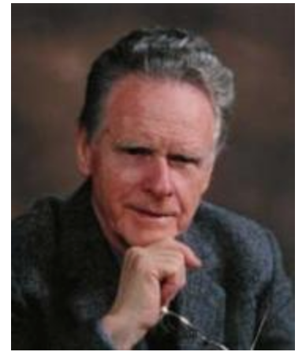


EM - Introduction
Generalized by Arthur Dempster, Nan Laird, and Donald Rubin in a classic 1977 JRSSB paper, which is widely known as the “DLR” paper.
Arthur Dempster
Harvard University
Emeritus Professor of Statistics
Nan Laird
Harvard School of Public Health
professor in Biostatistics
Donald Rubin
Harvard University
Emeritus Professor of Statistics
Notes:
Journal of the Royal Statistical Society: Series B (Statistical Methodology) Impact factor:3.278.

Slide 19
What’s EM used for?
Some random variables are not observed
Directly maximizing the target likelihood function is very difficult
Typical applications:
Discovering the value of latent variables
Estimate parameters for finite mixtures (Example 2)
Estimating parameters of HMMS
Filling in missing data in a sample
Other applications

Slide 20

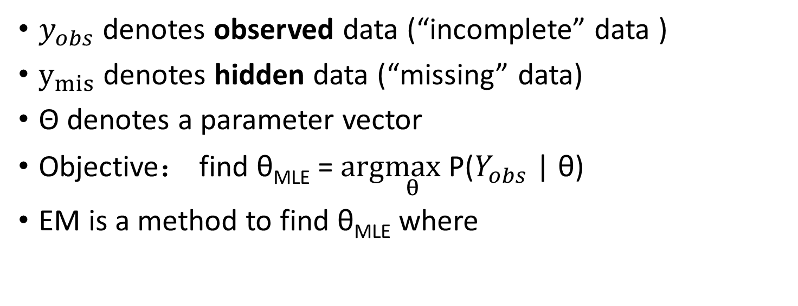
Basic setting in EM
$y_{obs}$ denotes observed data (“incomplete” data )
$y_{mis}$ denotes hidden data (“missing” data)
Θ denotes a parameter vector
Objective： find θ_{MLE} = $arg\max_{θ}$P($Y_{obs}$ | θ)
EM is a method to find θ_{MLE} where
Maximizing P($Y_{obs}$ | θ) directly is hard.
Working with P($Y_{obs},Y_{mis}$|θ) is much simpler

Slide 21
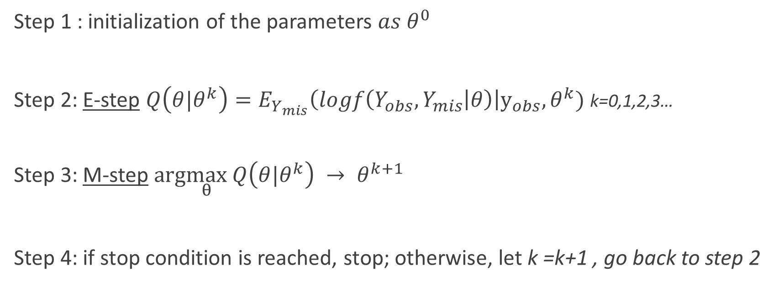
EM Algorithm
Step 1 : initialization of the parameters ${as θ}^{0}$
Step 2: E-step $Q\left(θ|θ^{k}\right)=E_{Y_{mis}}\left(logf\left(Y_{obs},Y_{mis} | θ\right)\right|y_{obs},θ^{k})$ k=0,1,2,3…
Step 3: M-step $arg\max_{θ} Q\left(θ|θ^{k}\right) → θ^{k+1}$
Step 4: if stop condition is reached, stop; otherwise, let k =k+1 , go back to step 2

Slide 22
EM Algorithm (informally)
Consider a set of starting parameters
Use these to “estimate” the missing data
Use “complete” data to update parameters
Repeat until convergence

Slide 23
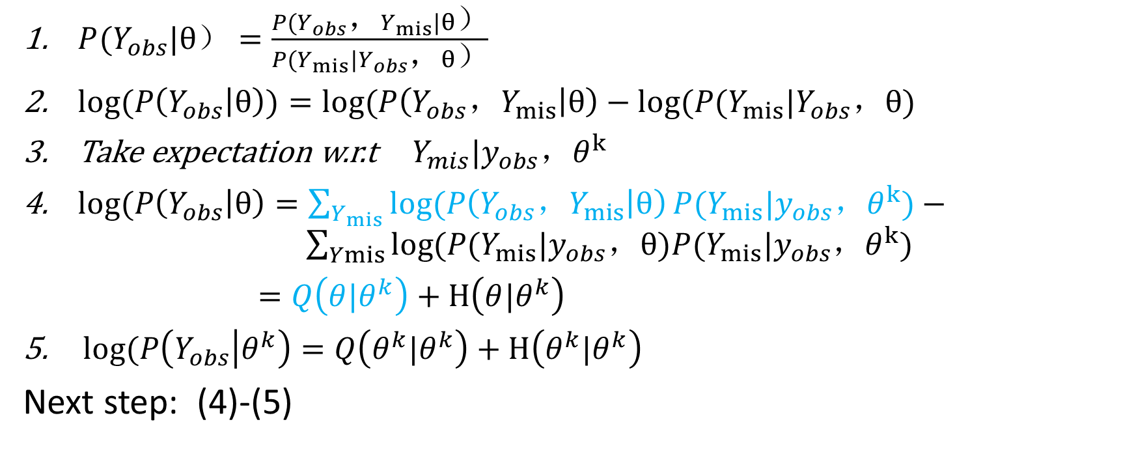
EM Why it works.
$P(Y_{obs}|θ）=\frac{P(Y_{obs}，Y_{mis}|θ）}{P(Y_{mis}|Y_{obs}，θ）}$
$log(P\left(Y_{obs} | θ\right))=log⁡(P\left(Y_{obs}，Y_{mis} | θ\right)−log⁡(P(Y_{mis}|Y_{obs}，θ)$
Take expectation w.r.t${ Y}_{mis}|y_{obs}，θ^{k}$
$log(P\left(Y_{obs} | θ\right)=\sum_{Y_{mis}}{log⁡(P\left(Y_{obs}，Y_{mis} | θ\right)}P(Y_{mis}|y_{obs}，θ^{k})− \sum_{Ymis}{log⁡(P(Y_{mis}|y_{obs}，θ)P(Y_{mis}|y_{obs}，θ^{k})}$
$=Q\left(θ|θ^{k}\right)+H\left(θ|θ^{k}\right)$
5. $log(P\left(Y_{obs} | θ^{k}\right)=Q\left(θ^{k}|θ^{k}\right)+H\left(θ^{k}|θ^{k}\right)$
Next step: (4)-(5)

Slide 24
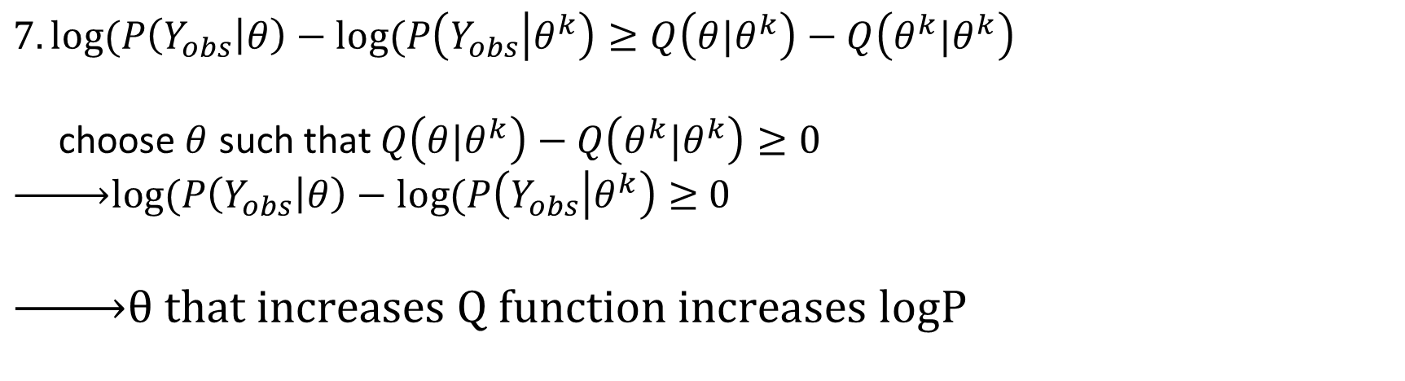
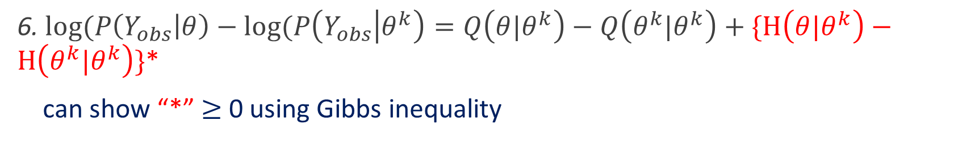
EM: a short derivation
6. $log(P\left(Y_{obs} | θ\right)−log(P\left(Y_{obs} | θ^{k}\right)=Q\left(θ|θ^{k}\right)−Q\left(θ^{k}|θ^{k}\right)+\{H\left(θ|θ^{k}\right)−H\left(θ^{k}|θ^{k}\right)\}$*
can show “*” $≥$ 0 using Gibbs inequality
$$7.log(P\left(Y_{obs} | θ\right)−log(P\left(Y_{obs} | θ^{k}\right)≥Q\left(θ|θ^{k}\right)−Q\left(θ^{k}|θ^{k}\right)$$
choose$θ$ such that $Q\left(θ|θ^{k}\right)−Q\left(θ^{k}|θ^{k}\right)≥0$
$\underset{→}{ }log(P\left(Y_{obs} | θ\right)−log(P\left(Y_{obs} | θ^{k}\right)≥$ $0$
$\underset{→}{ }θ that increases Q function increases logP$

Slide 25
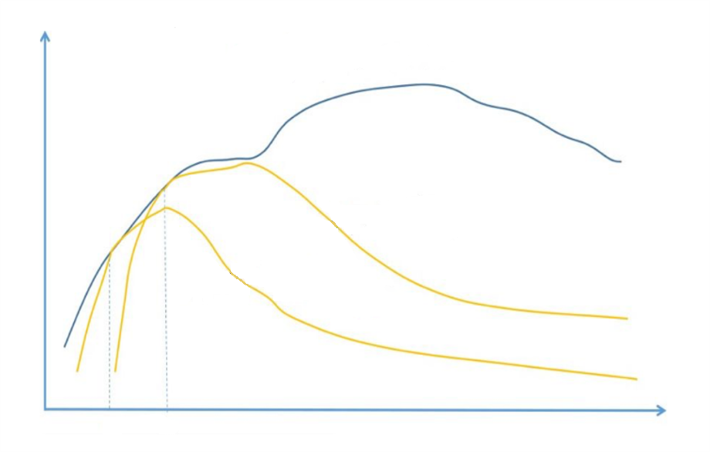




Graphic representation of one iteration of EM algorithm
$$Q(θ|θ^{k})$$
$$Q(θ|θ^{k+1})$$
$$θ^{k}$$
$$θ^{k+1}$$

Slide 26
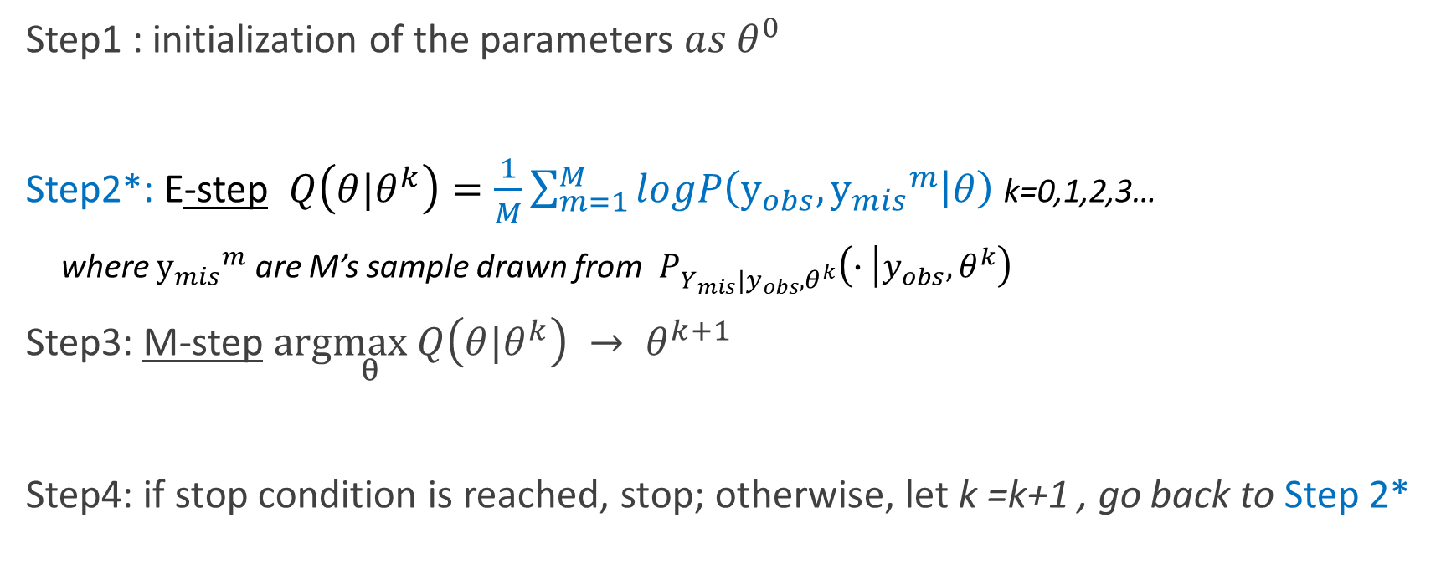
Monte Carlo EM
Step1 : initialization of the parameters ${as θ}^{0}$
Step2*: E-step $Q\left(θ|θ^{k}\right)=\frac{1}{M}\sum_{m=1}^{M}{logP\left(y_{obs}, {y_{mis}}^{m} | θ\right)}$ k=0,1,2,3…
where ${y_{mis}}^{m}$ are M’s sample drawn from $P_{Y_{mis}{|y}_{obs},θ^{k}}\left(∙ | y_{obs},θ^{k}\right)$
Step3: M-step $arg\max_{θ} Q\left(θ|θ^{k}\right) → θ^{k+1}$
Step4: if stop condition is reached, stop; otherwise, let k =k+1 , go back to Step 2*

Slide 27
EM for Multinomial case

Slide 28
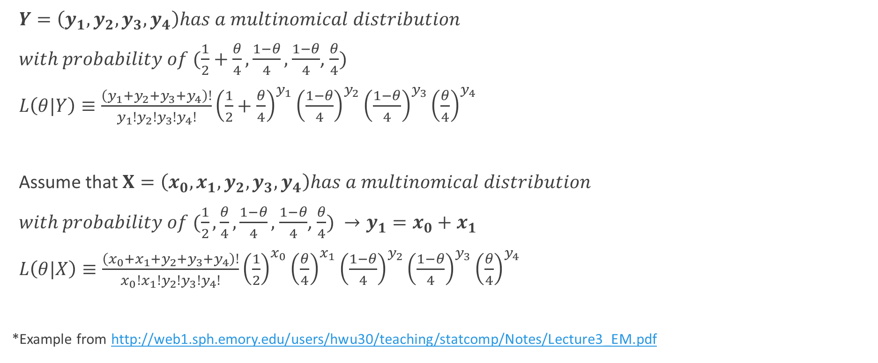


Discover the value for latent variables (Multinomial)
$Y=\left(y_{1},y_{2},y_{3},y_{4}\right)has a multinomical distribution$
$with probability of (\frac{1}{2}+\frac{θ}{4},\frac{1−θ}{4},$ $\frac{1−θ}{4}$, $\frac{θ}{4})$
$L\left(θ|Y\right)≡\frac{\left(y_{1}+y_{2}+y_{3}+y_{4}\right)!}{y_{1}!y_{2}!y_{3}!y_{4}!}{\left(\frac{1}{2}+\frac{θ}{4}\right)}^{y_{1}}{\left(\frac{1−θ}{4}\right)}^{y_{2}}{\left(\frac{1−θ}{4}\right)}^{y_{3}}{\left(\frac{θ}{4}\right)}^{y_{4}}$
Assume that $X=\left(x_{0},x_{1},y_{2},y_{3},y_{4}\right)has a multinomical distribution$
$with probability of (\frac{1}{2},\frac{θ}{4},\frac{1−θ}{4},$ $\frac{1−θ}{4}$, $\frac{θ}{4}) →y_{1}=x_{0}+x_{1}$
$L\left(θ|X\right)≡\frac{\left(x_{0}+x_{1}+y_{2}+y_{3}+y_{4}\right)!}{{x_{0}!x}_{1}!y_{2}!y_{3}!y_{4}!}{\left(\frac{1}{2}\right)}^{x_{0}}{\left(\frac{θ}{4}\right)}^{x_{1}}{\left(\frac{1−θ}{4}\right)}^{y_{2}}{\left(\frac{1−θ}{4}\right)}^{y_{3}}{\left(\frac{θ}{4}\right)}^{y_{4}}$
*Example from http://web1.sph.emory.edu/users/hwu30/teaching/statcomp/Notes/Lecture3_EM.pdf
$$Y_{obs}$$
$${Y_{obs},Y}_{mis}$$

Slide 29
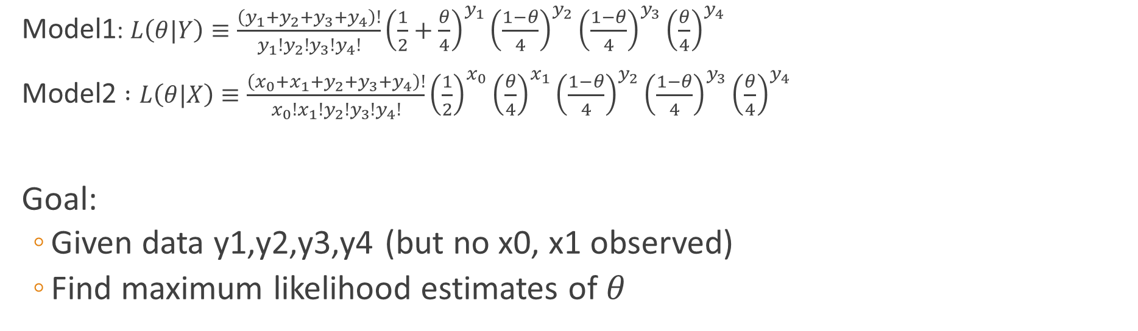
Multinomial case
Model1: $L\left(θ|Y\right)≡\frac{\left(y_{1}+y_{2}+y_{3}+y_{4}\right)!}{y_{1}!y_{2}!y_{3}!y_{4}!}{\left(\frac{1}{2}+\frac{θ}{4}\right)}^{y_{1}}{\left(\frac{1−θ}{4}\right)}^{y_{2}}{\left(\frac{1−θ}{4}\right)}^{y_{3}}{\left(\frac{θ}{4}\right)}^{y_{4}}$
Model2 $:L\left(θ|X\right)≡\frac{\left(x_{0}+x_{1}+y_{2}+y_{3}+y_{4}\right)!}{{x_{0}!x}_{1}!y_{2}!y_{3}!y_{4}!}{\left(\frac{1}{2}\right)}^{x_{0}}{\left(\frac{θ}{4}\right)}^{x_{1}}{\left(\frac{1−θ}{4}\right)}^{y_{2}}{\left(\frac{1−θ}{4}\right)}^{y_{3}}{\left(\frac{θ}{4}\right)}^{y_{4}}$
Goal:
Given data y1,y2,y3,y4 (but no x0, x1 observed)
Find maximum likelihood estimates of $θ$

Slide 30
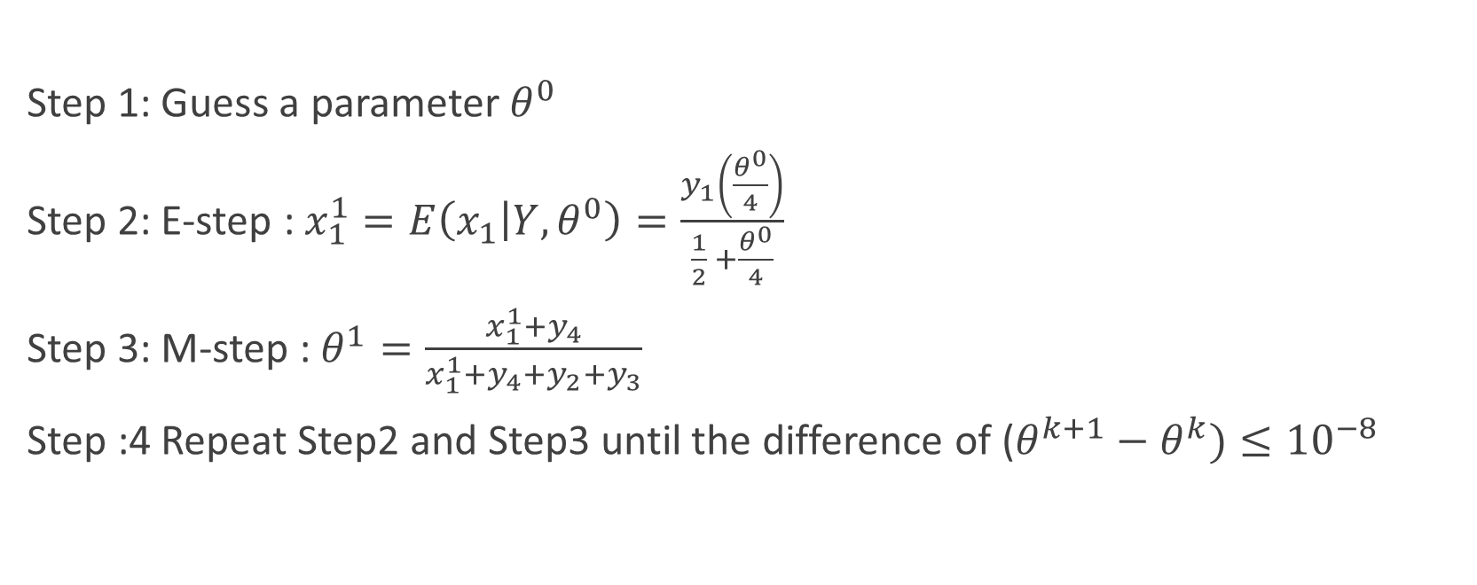
EM Algorithm
Step 1: Guess a parameter $θ^{0}$
Step 2: E-step : $x_{1}^{1}=E\left(x_{1} | Y,θ^{0}\right)=\frac{y_{1}\left(\frac{θ^{0}}{4}\right)}{\frac{1}{2} +\frac{θ^{0}}{4}}$
Step 3: M-step : $θ^{1}=\frac{x_{1}^{1}+y_{4}}{x_{1}^{1}+y_{4}+y_{2}+y_{3}}$
Step :4 Repeat Step2 and Step3 until the difference of ($θ^{k+1}−θ^{k})≤{10}^{−8}$
$$Q\left(θ,θ^{0}\right)=E\left(logf\left(Y_{obs},Y_{mis} | θ\right)\right|Y_{obs},θ^{0})$$
M step (Handout)

Slide 31
R Result for multinomial case

Slide 32
MCEM for Multinomial case

Slide 33
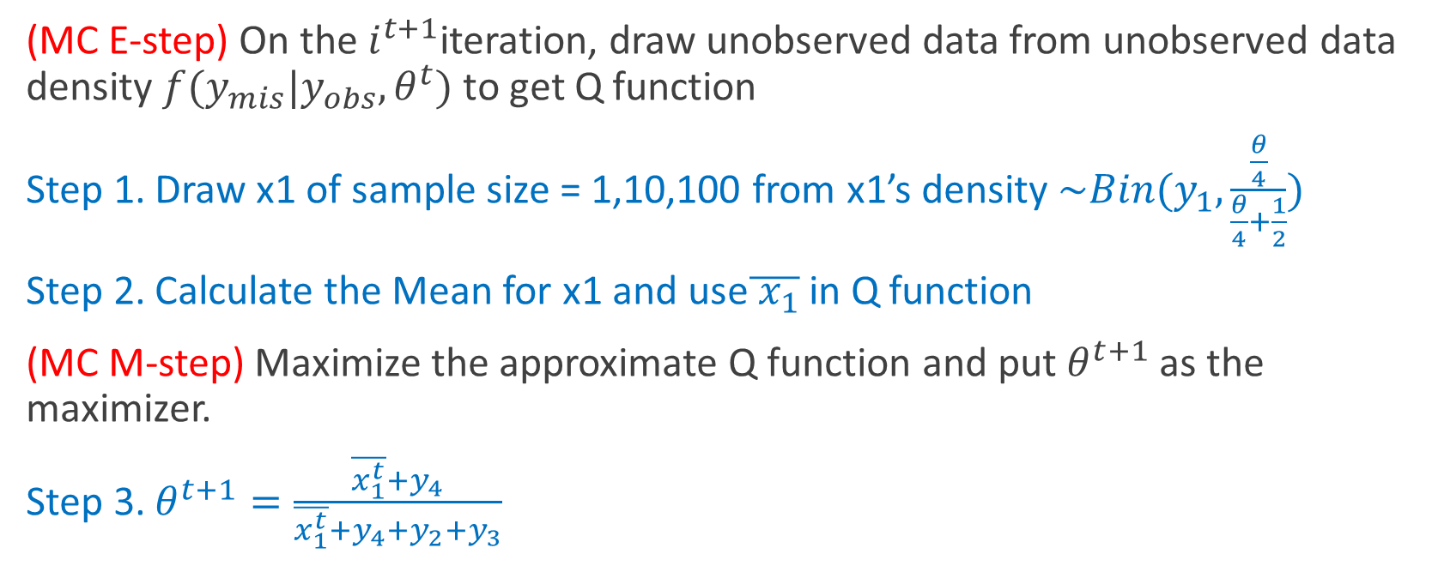
MCEM for Multinomial case
(MC E-step) On the $i^{t+1}$iteration, draw unobserved data from unobserved data density $f(y_{mis}|y_{obs},θ^{t})$ to get Q function
Step 1. Draw x1 of sample size = 1,10,100 from x1’s density $\sim Bin(y_{1},\frac{\frac{θ}{4}}{\frac{θ}{4}+\frac{1}{2}})$
Step 2. Calculate the Mean for x1 and use$\overline{{ x}_{1}}$ in Q function
(MC M-step) Maximize the approximate Q function and put $θ^{t+1}$ as the maximizer.
Step 3. $θ^{t+1}=\frac{\overline{x_{1}^{t}}+y_{4}}{\overline{x_{1}^{t}}+y_{4}+y_{2}+y_{3}}$

Slide 34
R Result for MCEM multinomial case

Slide 35
EM – Two component GMM

Slide 36
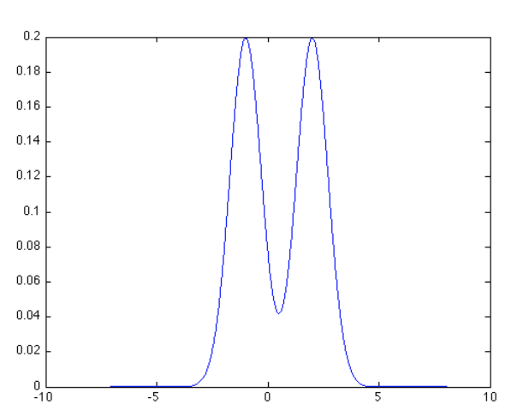
Estimate parameters for finite mixtures (Two-component Normal Mixture Model)

Slide 37
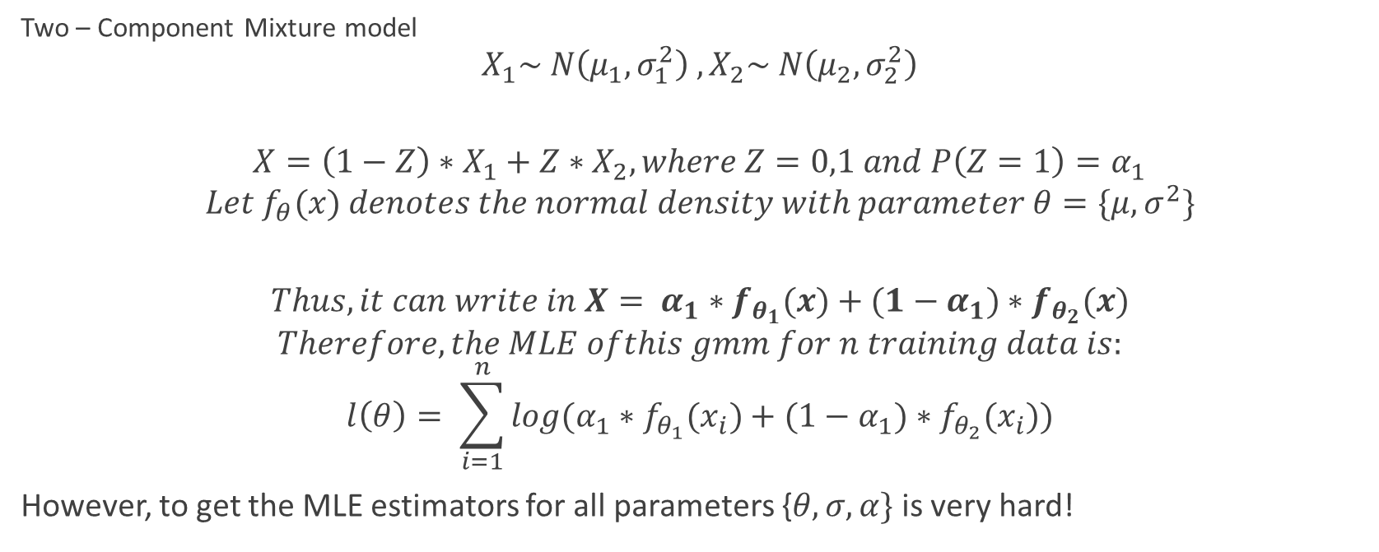
What is GMM?
Two – Component Mixture model
$$X_{1}\sim N\left(μ_{1},σ_{1}^{2}\right) ,X_{2}\sim N\left(μ_{2},σ_{2}^{2}\right)$$
$$X=\left(1−Z\right)∗X_{1}+Z∗X_{2},where Z=0,1 and P\left(Z=1\right)=α_{1}$$
$$Let f_{θ}(x) denotes the normal density with parameter θ=\{μ,σ^{2}\}$$
$$Thus, it can write in X= α_{1}∗f_{θ_{1}}(x)+{(1−α}_{1})∗f_{θ_{2}}(x)$$
$$Therefore, the MLE ofthis gmm for n training data is:$$
$$l\left(θ\right)= \sum_{i=1}^{n}{{log(α}_{1}∗f_{θ_{1}}(x_{i})+{(1−α}_{1})∗f_{θ_{2}}(x_{i}))}$$
However, to get the MLE estimators for all parameters {$θ,σ,α\}$ is very hard!

Slide 38
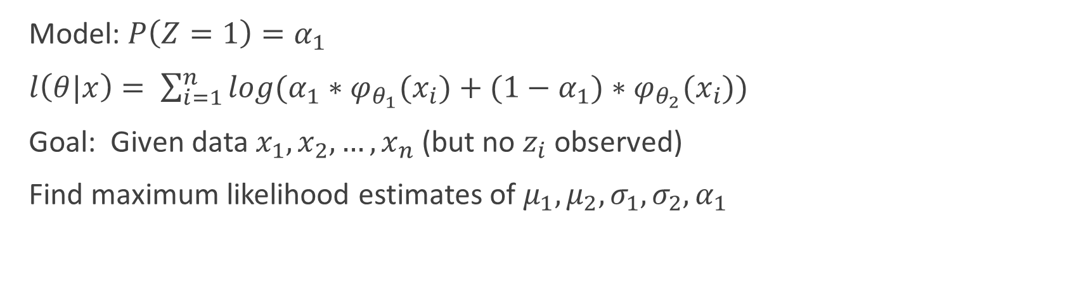
EM
Model: $P\left(Z=1\right)=α_{1}$
$l\left(θ|x\right)= \sum_{i=1}^{n}{{log(α}_{1}∗φ_{θ_{1}}(x_{i})+{(1−α}_{1})∗φ_{θ_{2}}(x_{i}))}$
Goal: Given data $x_{1},x_{2},…,x_{n}$(but no $z_{i}$ observed)
Find maximum likelihood estimates of $μ_{1},μ_{2},σ_{1},σ_{2},α_{1}$

Slide 39
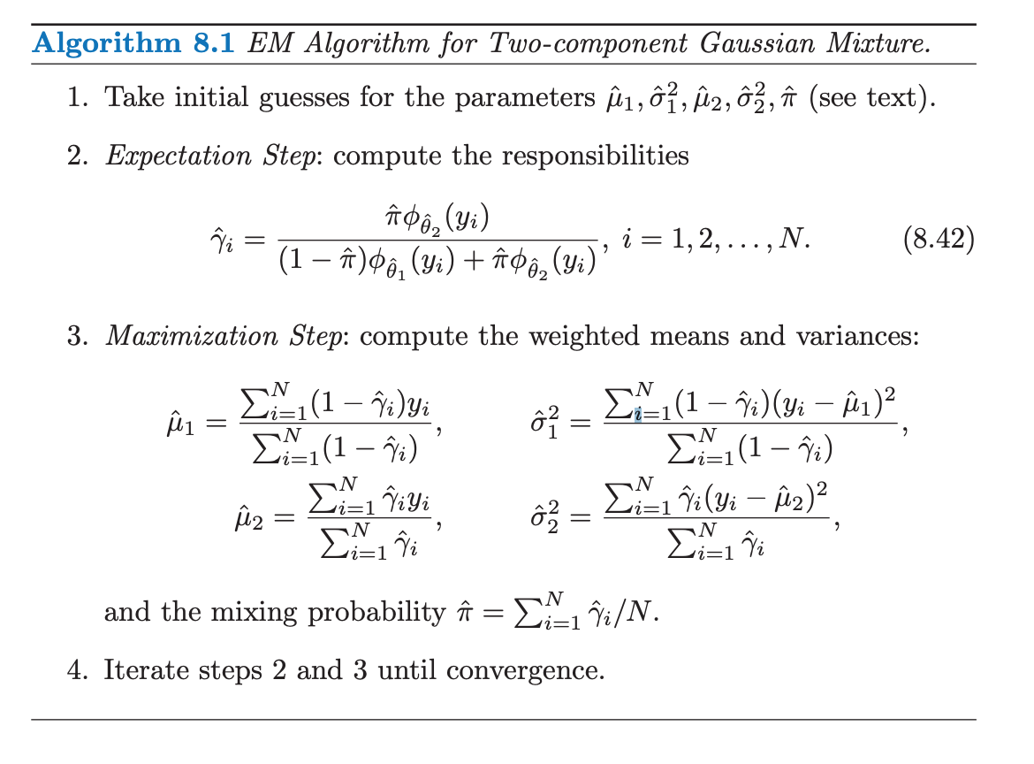
From https://web.stanford.edu/~hastie/Papers/ESLII.pdf P275

Slide 40
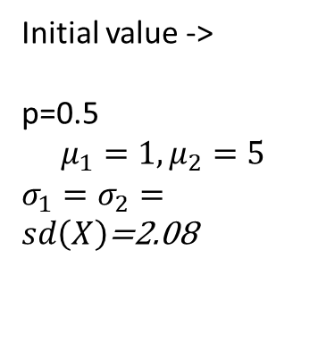
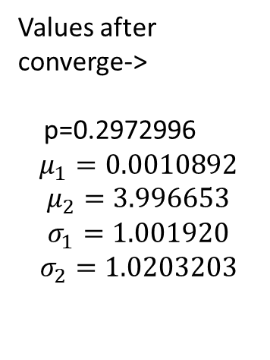
R Result for Two component GMM case
Initial value ->
p=0.5
$$μ_{1}=1, μ_{2}=5$$
$σ_{1}=σ_{2}=sd\left(X\right)$=2.08
Values after converge->
p=0.2972996
$$μ_{1}=0.0010892$$
$$μ_{2}=3.996653$$
$$σ_{1}=1.001920$$
$$σ_{2}=1.0203203$$

Slide 41
Cons and suggested solutions
Local vs. global max
• There may be multiple modes
• EM may converge to a saddle point
Starting points
• Bad starting points may hurt
Slow Convergence
• EM can be painfully slow
to converge near the maximum
Solution: Multiple starting points
Solution:
• Based on the information of the data
• Use the method of moment
Solution:
Find quicker convergence methods

Slide 42
References
http://people.missouristate.edu/songfengzheng/Teaching/MTH541/Lecture%20notes/MLE.pdf
http://web1.sph.emory.edu/users/hwu30/teaching/statcomp/Notes/Lecture3_EM.pdf
https://people.eecs.berkeley.edu/~pabbeel/cs287-fa13/slides/Likelihood_EM_HMM_Kalman.pdf
https://web.stanford.edu/~hastie/Papers/ESLII.pdf
Meilijson, Isaac. “A Fast Improvement to the EM Algorithm on Its Own Terms.” Journal of the Royal Statistical Society. Series B (Methodological), vol. 51, no. 1, 1989, pp. 127–138. JSTOR, www.jstor.org/stable/2345847.
Dempster, Laird & Rubin (1977, JRSSB,39:1-38

Slide 43
Questions

